Slide 1
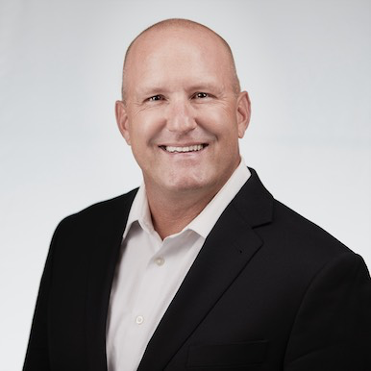

Patrick Scribner Data & AI
INDUSTRIES
Industry Experience
Higher Education | Manufacturing | Cannabis | Government/Defense Contracting | Environmental Science | Healthcare | Golf Courses and Country Clubs | Transportation | Mortgage
EXPERIENCE
Enterprise Process Assessment/Replacement | Analytical Laboratory
Problem: Client had a manual sample and result tracking system which wasn’t scaling to the increased workloads and was managed with a combination of Excel, disparate instruments and workers
Value: By automating and tying together the processes, they were able to visualize and communicate where the results were, when new ones were coming in and create batches of work that were optimized
Tools: Postgres, Python, Apache, AWS S3
Role: Functioned as a team lead and architect facilitating design sessions to gather project success requirements, feature engineering, data engineering and project progress reporting and accountability of final quality
Data – Integration | Construction Materials
Problem: Client was required to report to the EPA hazardous waste material management and transportation
Value: An integrated solution direct with the EPA’s new eManifest API resulted in substantial time savings of 120 hours per month that was spent on manual data entry and timing compliance was improved by 60%
Tools: Snowflake, SQL Server, Talend
Role: Functioned as designer and developer of the solution working with clients business SME’s to ensure that their functional and reporting requirement were met.
BACKGROUND
Functional Skills
Technology Leadership | Data Architecture | Data Engineering | Data Analysis and Visualization | Organizational Transformation | Automation
Qualifications:
Patrick is a visionary technology leader with a keen focus on crafting and executing data and technology strategies that drive innovation and propel businesses forward. With a wealth of industry experience, Patrick specializes in unraveling intricate challenges faced by a diverse array of enterprises, spanning from nimble startups to sprawling multinational corporations.
BIO & CONTACT INFO
Email
Patrick.Scribner@thebridge.com
Mobile
(720) 394-8149
Location
Denver, CO
Patrick has over 25 years in technology with 10 of those years as a lead consultant. He’s passionate about helping companies with their challenges and delivering measurable value. In his free time, he enjoys spending time with his family, camping in the Colorado wilderness and playing golf.

